Slide 1

Restaurant Recommendation System
Group Members:
Salma Roohi,
Megha Nawale,
Akintonde Abbas,
Manoj Pammina

Slide 2
Content
Introduction
Types of Recommendation Systems
Problem Statement
Tools and Libraries Used
Latent Factor Collaborative Filtering
Neighborhood-Based Method
Conclusion
Future Scope

Slide 3
Types of Recommendation Systems

Slide 4
Tools and Libraries used
Programming Language- Python 3
Tools: Anaconda- Jupyter Notebook as editor
Libraries:
NumPy – To support multi-dimensional arrays and matrices operation.
Pandas- To load, prepare and analyze data
sklearn.model_selection- for train-test split-sampling a dataset and estimating an unknown quantity
sklearn.feature_extraction.text: TfidfVectorizer-To extract features from dataset into vectors
NLTK.corpus : stopwords – To remove stopwords from reviews
nltk.tokenize:WordPunctTokenizer- To split text into small words or tokens

Slide 5
Processing of Review into Metrics
Working with NLTK
Removal of stop words and tokenize the review text
Example: Removal of stop words
Review text with stop words | Review without Stop Words
I like this burger and pizza also very delicious. | Like burger, pizza delicious

Slide 6
Latent Factor Collaborative Filtering
This method is based on finding latent feature (Hidden feature).
Extract features of users and restaurant from reviews loaded from dataset using TfidfVectorizer.
Minimize the error by using Gradient Decent formula(Optimization).
Make recommendation to user based on user search criteria

Slide 7
Feature Extraction

Slide 8
Matrix Factorization of rating matrix
Restaurant/ Features | R1 | R2 | R3 | R4 | R5
Pizza | 3 | 1 | 1 | 3 | 1
Burger | 1 | 2 | 4 | 1 | 3
User /Features | Pizza | Burger
User1 | 1 | 0
User2 | 0 | 1
User3 | 1 | 0
User4 | 1 | 1
Restaurant/User | R1 | R2 | R3 | R4 | R5
User1 | 3 | 1 | 1 | 3 | 1
User2 | 1 | 2 | 4 | 1 | 3
User3 | 3 | 1 | 1 | 3 | 1
User4 | 4 | 3 | 5 | 4 | 4

Slide 9
Missing Rating Prediction
Gradient descent algorithm for optimization

Slide 10
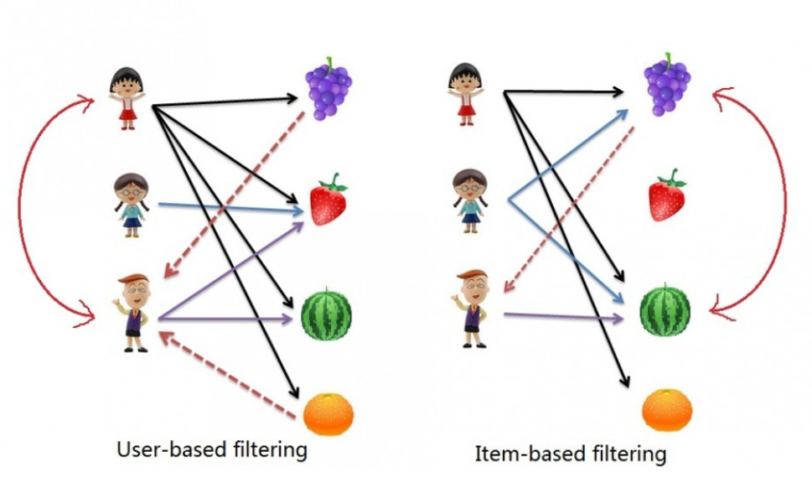
Neighborhood-Based Method
The neighborhood-based method uses direct comparisons between users or items.
Source: http://www.salemmarafi.com/code/collaborative-filtering-with-python/

Slide 11
Neighborhood-Based Restaurant Recommendation
Aggregate text reviews for each restaurant and convert to matrix vectors.
Obtain similarity between user input text and existing restaurant text reviews
Sort similar restaurants using similarity score and average restaurant ratings
Make recommendation to user

Slide 12
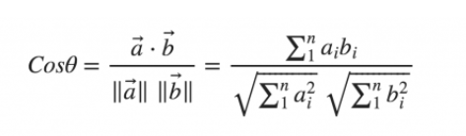
Similarity Metrics
Cosine Similarity
Computes angle between two vectors in a multidimensional space
More accurate than Euclidean distance methods that compute magnitudes of distance between vectors instead.
Not biased towards the size of individual documents or body of text.

Slide 13
Comparison between two methods
The idea is that these latent (hidden) features captures more of the relationships between users and items than neighborhood models, at the expense of explainability.
Initial model development can be computationally intensive in latent factor methods due to the nonlinear optimization involved.
Scalability: Latent Factor collaborative method is more scalable than Neighborhood method.

Slide 14
Conclusion
Recommendation system can be developed by using other user’s review.
Review need to be processed using natural language processing toolkit to remove unwanted words.
User and Restaurant feature extraction required to form matrices.
Latent factor collaboration method could be more robust than simple neighborhood approach. Involves computationally intensive optimization

Slide 15

Future Scope
For this projects we referred only one data set from Yelp application, For more accurate recommendation, datasets can be used from several multiple applications.
Recommendation based on food price range and opening hours.
Recommendation system can be built by using latent factor and K-nearest neighbor method.

Slide 16
References
Y. Koren, R. Bell, and C. Volinsky, Matrix factorization techniques for recommender systems. Computer, 42(8):30–37, 2009.
Matt Gormley , Matrix Factorization and Collaborative Filtering
Rabin P, Latent factor based method in collaborative filtering
Dheeraj B, Debajyoti M, Matrix factorization model in collaborative filtering algorithms

Slide 17
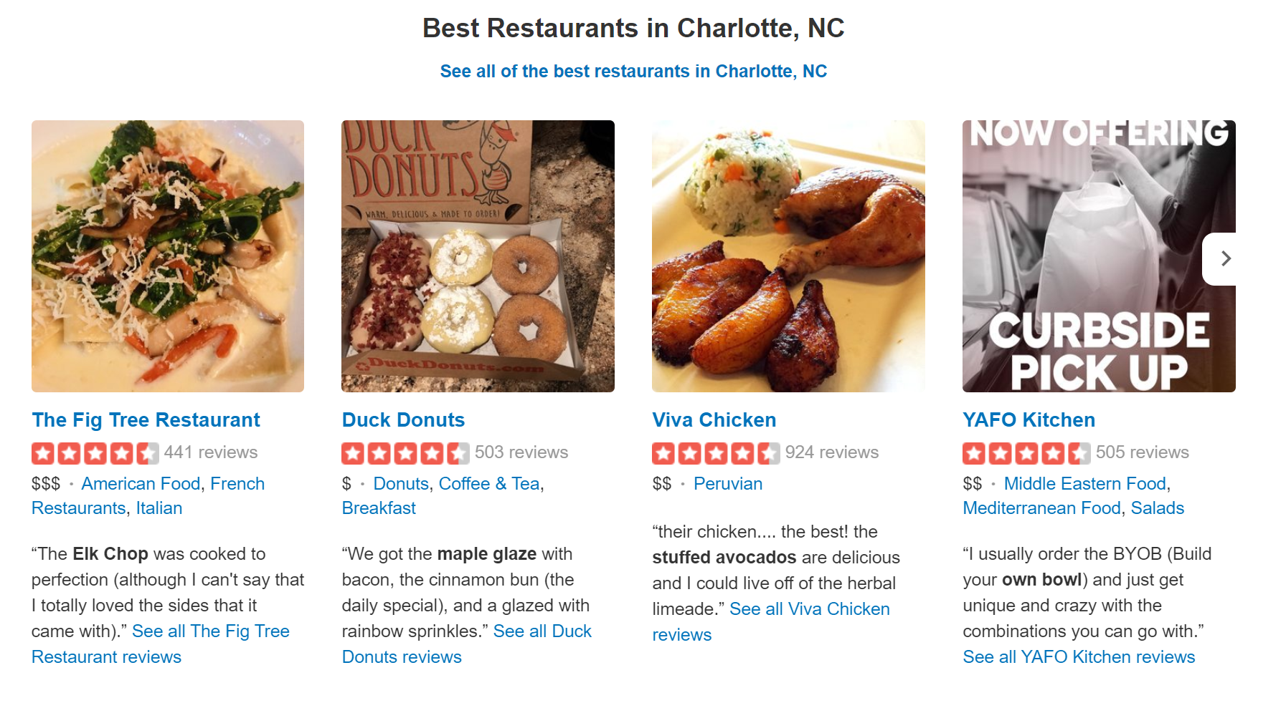
Thank You!

